Slide 1





PRESENTATION 2026
Assessing Occupational Burnout Among Teachers in Lucknow City
Faculty Name
Mentor Name
Faculty Email
Dr. Kritika Malhotra
Umamaheshwari R
Drkritika.nationalpgcolllege@npgc.in

Slide 2
edunet
foundation
OUTLINE
• Abstract of the Project
• Problem Statement
• Proposed Solution
• System Architecture
• Live Demo of the Project
• Embedded Video of Project
• Conclusion
• Future Scope

Slide 3
edunet
foundation
Abstract
This project assesses occupational burnout among 54 teachers in Lucknow City using a multidimensional, data-driven approach.
The objective is to identify burnout patterns across academic streams and provide evidence-based recommendations for institutional interventions.
Tools and technologies used include the Burnout Assessment Tool (BAT), WHO-5 Well-Being Index, Microsoft Excel, IBM SPSS, Power BI, and Microsoft Copilot and MS Copilot Studio.
Expected outcomes include identification of high-risk groups, comparative analysis across streams, and a scalable framework for burnout monitoring.
Key highlights include significant findings on mental distress, psychosomatic complaints and cognitive impairment, integration of AI for analysis, and a focus on the Indian higher education context.

Slide 4
edunet
foundation
Problem Statement
The core problem is the absence of a structured, standardized mechanism to assess occupational burnout among teachers across multiple academic streams in Indian higher education institutions.
This problem is significant because unmeasured burnout leads to undetected faculty distress, declining teaching quality, increased absenteeism, and higher attrition rates, ultimately damaging institutional reputation.
Target users affected include faculty members across all streams (Science, Humanities, Commerce), institutional administrators, and policymakers responsible for faculty welfare and retention.

Slide 5
edunet
foundation
Proposed Solution
The proposed solution is a structured, data-driven burnout assessment framework using the Burnout Assessment Tool (BAT) to measure both core and secondary dimensions of teacher burnout across academic streams and measuring faculty well-being through WHO Well-Being Index.
This approach solves the identified problem by providing standardized measurement, comparative analysis across departments, and objective evidence of burnout for faculty appraisals and institutional support.
Methodology includes cross-sectional quantitative design data collection via Google Forms (68 responses, cleaned to 54), reliability testing (Cronbach's Alpha = 0.82), correlation analysis, and ANOVA to compare burnout across streams.
Key benefits include multidimensional burnout measurement (exhaustion, mental distance, emotional impairment, cognitive impairment, psychosomatic symptoms), identification of high-risk streams (Humanities and Commerce), and actionable recommendations for workload rationalization and wellness programs.

Slide 6
edunet
foundation
System Architecture
Data Input / Source
Processing / Analysis
Data was collected through a Google Forms questionnaire from teachers. This project uses manually collected survey data without any external APIs or databases.
Cleaned the data using Microsoft Excel- removed duplicates, handled missing values, and standardized the responses into numerical format. Transformed the data- organized variables and calculated scores for BAT dimensions. Further analysis was performed using SPSS (Cronbach’s Alpha, correlation, ANOVA), along with Power BI for visualization and Copilot for insights and reporting.
AI / Tool Integration
Output / Dashboard
Microsoft Excel for data cleaning, coding, and initial analysis. IBM SPSS for integrated and advanced statistical analysis such as reliability testing, correlation, and ANOVA. Power BI used to create interactive dashboards and visualizations, while Microsoft Copilot and AI chatbots used for generating insights, interpretations, and report content
The final output includes a detailed analytical report, along with interactive dashboards and charts created using Power BI. It represents burnout patterns, statistical results, and insights in a clear and visual format for better understanding and quality decision-making.

Slide 7
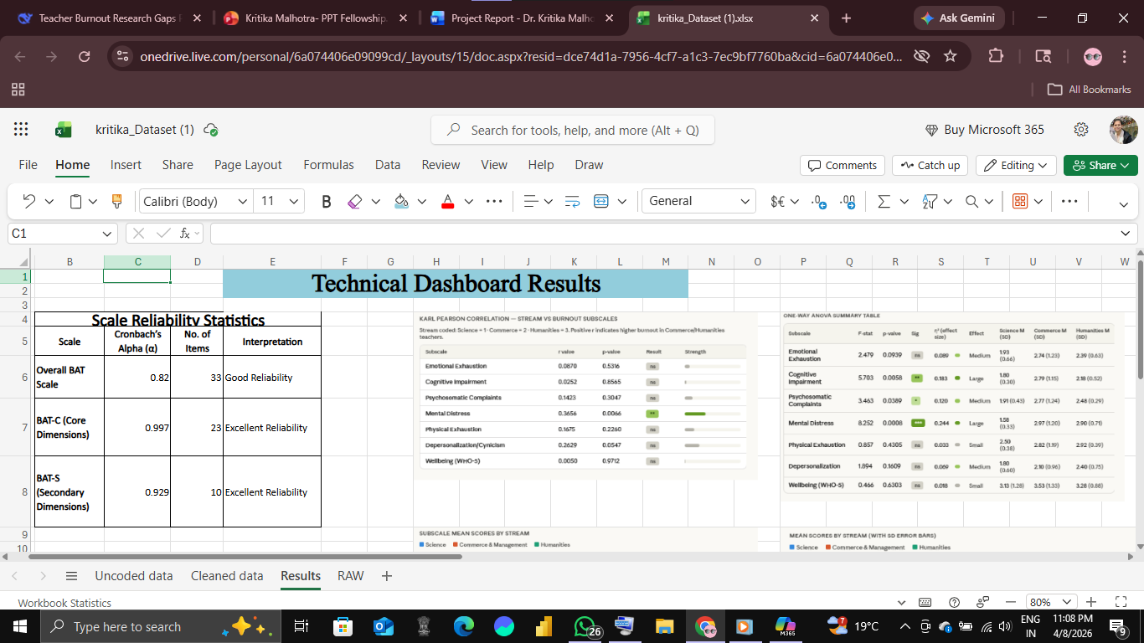
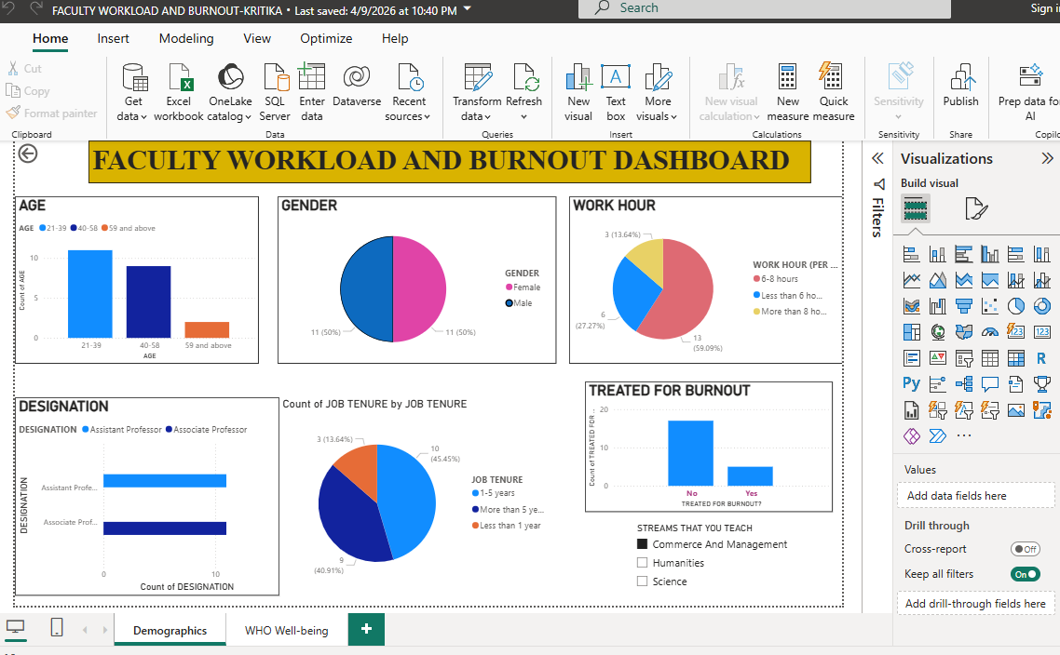
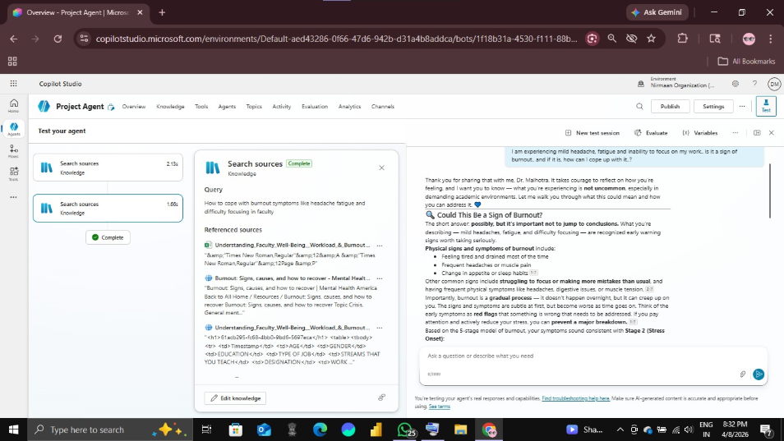
edunet
foundation
Live Demo of Project
Here's the list of some demo screenshots / features of the project:
🖼
🖼
🖼
Excel Technical Dashboard
Power BI Dashboard
Copilot Studio Agent
[Add description of Demo 1 here — what this demo shows, key features, and results achieved.]

Slide 8
edunet
foundation
Video of Project Demo
[https://your-project-demo-link.com]
▶
[Insert your project demo video.
You can embed a video your live project.]

Slide 9
edunet
foundation
Conclusion
Key findings reveal significant differences across academic streams, with Humanities and Commerce faculty showing higher burnout levels, particularly in psychosomatic complaints and cognitive impairment.
All objectives were achieved, including data cleaning, statistical analysis (Cronbach's Alpha, ANOVA, correlation), interactive dashboards in Power BI, and AI integration using Microsoft Copilot.
The project adds value by providing a scalable, evidence-based model for early burnout detection, enabling institutions to implement targeted interventions such as workload management and mental health support.
Overall, this work demonstrates how modern analytics and AI tools can effectively address real-world problems in the Indian higher education sector.
✅
• Abstract of the Project
• Problem Statement
• Proposed Solution
• System Architecture
• Live Demo of the Project
• Embedded Video of Project
CONCLUSION
• Conclusion
• Future Scope

Slide 10
edunet
foundation
Future Scope
🧠
Integrate real-time data pipelines using Power Automate or APIs for live monitoring of burnout levels.
Apply machine learning techniques (predictive modeling, anomaly detection) to identify early warning signs of burnout.
Develop a web-based dashboard or Power Apps interface for non-technical administrators to access insights easily.
Expand the sample size across multiple institutions and cities for better generalizability.
Include additional variables such as job satisfaction, work-life balance, and institutional support for deeper analysis.
Implement automated reporting systems to generate periodic alerts and summaries for decision-makers.
• Abstract of the Project
• Problem Statement
• Proposed Solution
• System Architecture
• Live Demo of the Project
• Embedded Video of Project
• Conclusion
[Future ideas & roadmap]
• Future Scope

Slide 11
edunet
foundation
Thank You
AICW Fellowship | Student Project Presentation 2026
LinkedIn | Edunet Foundation

